Slide 1
SWE2008 – Android Programming
Prof. J. Christy Jackson

Slide 2
Welcome back to VIT
Please make sure you are sitting in the correct class
SWE2008 Android Programming– D1+TD1 Slot – AB2 303 – Christy Jackson.

Slide 3
Very Little About Me
Name: J. Christy Jackson
B.E (CSE)- Karunya University, Coimbatore
MS(IT)- Griffith University, Brisbane, Australia
Worked as an Oracle SQL forms and reports developer and now in VIT
Email: christyjackson.j@vit.ac.in
Phone: +91 8939109547 ( WhatsApp is appreciated)
Location: AB1 4th Floor Annexure Cabin No: 20

Slide 4
Text Book
Joseph Annuzzi, Jr., Lauren Darcey, Shane Conder, “Introduction to Android Application Development”, Create Space Independent Publishing Platform, Fourth Edition, 2014.
Reference Books
1. Wei-Meng Lee, Beginning Android 4 Application Development, Wrox, 2012
2. Budi Kurniawan. Introduction to Android Application Development, 2014
3. Dawn Griffiths, Head First Android Development, O’reilly, 2015
4. Rajiv Ramnath, Roger Crawfis, and Paolo Sivilotti, Android SDK 3 for Dummies, Wiley, 2011
5. Rick Rogers, John Lombardo, Zigurd Mednicks and Blake Meike , “ Android

Slide 5
Marks Split Up - Theory
CAT – I 50 Marks 15 Marks
CAT - II 50 Marks 15 marks
Digital Assignment 30 Marks 30 Marks
TEE 100 Marks 40 Marks
Total 100 Marks

Slide 6
Project Marks Split Up
Review-1 – 20 marks
Review-2 – 30 marks
Review-3 – 50 marks

Slide 7
Examinations
Model Question Paper will be given well in advance
Marks split up for each question and how many questions would be there in the exam
This applies for CAT as well as Term End Exams

Slide 8
Project
Maximum of 3 Students in a Group
Should create an android mobile application
At the end of the project, App has to be deployed on the mobile phone
Every App should have an integration of either the database of google maps

Slide 9
Edmodo
Social Learning Website
Assignments, Course Materials, Quizzes, Forums
www.edmodo.com
Mobile app for both android and iOS users
Sign up as a student and add yourself to the group
I will give you the group code probably in the next class

Slide 10
Pre-requisite
SWE1007 has to be completed
Should have strong fundamental knowledge on Java

Slide 11
Basic Java Test
How will you create an Object in Java
How will you inherit from a parent class?

Slide 12
Basic Java Test – Answer -1
Class_Name Object_Name = new Class_Name();
Helloclass helloobject = new Helloclass();

Slide 13
Basic Java Test – Answer -2
class Super {
.....
.....
}
class Sub extends Super {
.....
.....
}

Slide 14
Lab Class and Virtual Class

Slide 15
Guidelines for a Successful Android Programming Course
Notebook and Pen is compulsory for this course
Try to be on time
Attendance will become a major issue if you do not maintain 75%
Be attentive in the class and please DO NOT talk during the lecture
Follow the tips given for answering the Higher order thinking (HOT) questions
Learn Programming (No other choice)
Mobile phones are prohibited
Punishments will be given

Slide 16
Class Rep and WhatsApp Group
Volunteer to be Rep

Slide 17
Module -1 Introduction to mobile and Android
History of mobile

Slide 18
Brief History Of Mobile

Slide 19

The beginning…

Slide 20
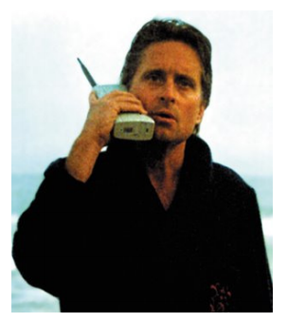
The Brick Era
It was Portable! calls
It was Portable!
More expensive than payphones
Enormous battery
Stakeholders: – Stockbrokers, salespeople, …
After a while, more cellular radio towers and… it got (a little bit) smaller

Slide 21
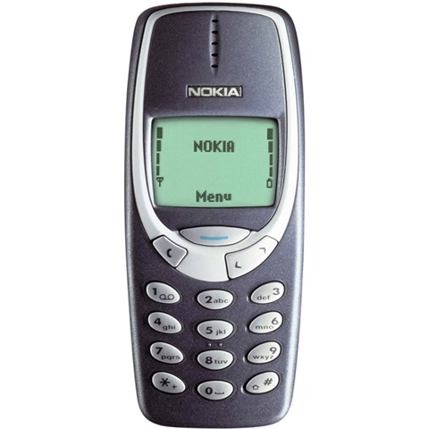
The Candy Bar Era
2G network : GSM, CDMA, TDMA, SMS
More cellular towers less power needed much smaller
Better voice quality
Added SMS
Everyone wanted to have a mobile phone – economic prosperity in EU, USA, and JP

Slide 22
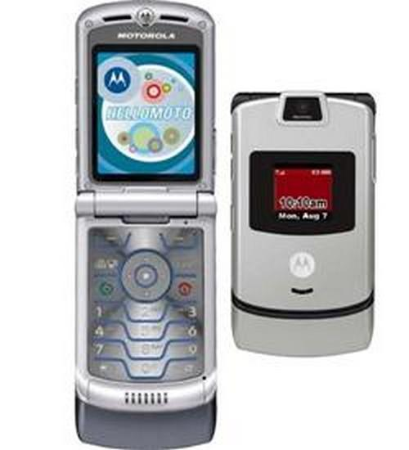
The Feature Phone Era
2.5G network: GPRS calls SMS & MMS music & photos
Camera
MMS
Data-capable devices
Internet on mobile (very poor)
high prices
poor marketing
inconsistent rendering

Slide 23
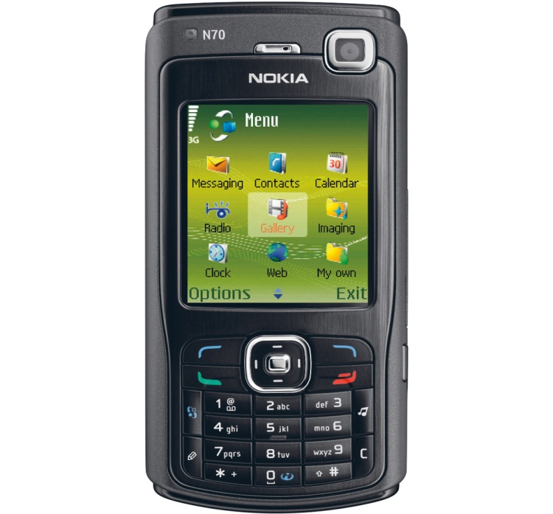
The Smartphone Era
3G, HSDPA, WI -FI calls SMS & MMS music & photos
3G, HSDPA, WI -FI
Like a feature phone, but simulating a PC
Its own OS (es. Symbian)
Larger screens, stylus
The Mobile Platform becomes key
(push) email as primary driver

Slide 24
The Touch Era
3G, 4G calls SMS & MMS music & photos APPS
Accelerometers
GPS/Location-based
User-centered design – true impact on his eveyday life
true impact on his everyday life
• Rich interfaces
• A personal media platform
• Mobile web - everyday

Slide 25
Wireless Application Protocol (WAP)
WAP was a stripped-down version of Hypertext Transfer Protocol (HTTP), which is the backbone protocol of the World Wide Web
WAP browsers were designed to run within the memory and bandwidth constraints of the phone

Slide 26
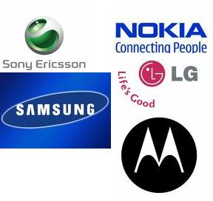






Mobile Ecosystem
Security
OEMs
Consumers
OS Vendors
Services & Infrastructure
Developers
Carriers
Wireless Networks

Slide 27
Wireless Networks: Current Landscape
Wireless LANs
Cellular Networks
Proximity Technologies

Slide 28
Wireless LANs
Home & enterprise hotspots
High data rates
Easy to use, plug & play components
Integrated in hardware
Limited coverage area
802.11 family of standards

Slide 29
Cellular Networks
High mobility
Initially designed for voice
Real time, always-on
Extended to offer Internet & multimedia
Data rates lower than wifi
Deployed successfully all over the world
High error rates
Weak and proprietary cryptographic algorithms like COMP128

Slide 30
Proximity Technologies
Near Field Communication (NFC)
Inches
Secure
Bluetooth
Bluetooth versions 3 & 4
Security issues
Proximity detection & battery power

Slide 31
Wireless Networks: Use Cases
Mobile TV
Mobile Games
Video/Audio Streaming
Conferencing
Content Download
M2M Applications

Slide 32
Mobile Device Architecture
Applications
Software Stack
Operating System
Device Hardware

Slide 33
Operating Systems:
Real Time Operating Systems (RTOS)
Limited capacity, minimal
Specific use case
Compact
Efficient
Open Source and proprietary RTOS (BeRTOS, FreeRTOS, VxWorks, PikesOS, LynxOS, Nucleus RTOS)

Slide 34
Operating Systems: Smart Phones
Feature rich
Modern OS
Capabilities and services
Free and proprietary OS (J2ME, Symbian, FreeBSD, Linux variants like HP WebOS, Maemo)

Slide 35
Operating Systems & OEMs
OEMs bake OS into the device
OS cannot be changed
OS defines key features of device
Security characteristics
Multithreading
Resource sharing

Slide 36
Mobile Device Architecture
Applications
Software Stack
Operating System
Device Hardware

Slide 37
Software Stack
Software layer put on top of OS
Middleware or mobile platform
Stack exposes device capabilities
Defines application structure
Open source & proprietary (Android, iPhone, Blackberry OS)

Slide 38
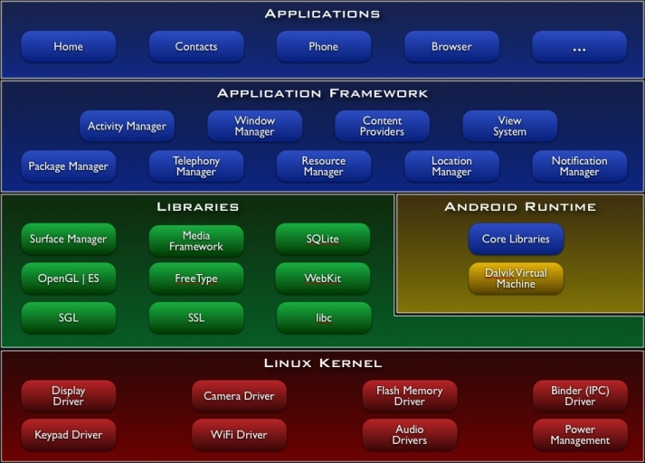
Android Architecture
http://developer.android.com/guide/basics/what-is-android.html

Slide 39
Difference between SDK and API
an API is an interface. It's like the specification of the telephone system or the electrical wiring in your house. Anything can use it as long as it knows how to interface. You can even buy off-the-shelf software to use a particular API, just as you can buy off the shelf telephone equipment or devices that plug into the AC wiring in your house.
an SDK is implementation tooling. It's like a kit that allows you to build something custom to hook up to the telephone system or electrical wiring.

Slide 40
API Vs SDK
Examples of APIs:
Examples of SDKs:
Java API
Google Maps API
Flash Player API
JDK
GWT
Flex SDK
Android SDK

Slide 41
Why Mobile?

Slide 42
Size and Scope of the Mobile Market
China – 24%
India – 21%
United States – 6%
Indonesia – 4%
Brazil – 3%
Pakistan – 3%

Slide 43
Size and Scope of the Mobile Market
Mobile devices have already outpaced majority of media we rely on everyday, including computers
Today more people access the web via a mobile device than a computer
The largest and most available mass medium to mankind
This is a good justification to create mobile products/application

Slide 44
7th Mass Medium
First Mass Medium – Printing Press
Second Mass Medium – Recordings
Third Mass Medium – Cinema
Fourth Mass Medium – Radio
Fifth Mass Medium – Television
Sixth Mass Medium – The Internet
Seventh Mass Medium – Mobile Phone

Slide 45
Mobile’s Unique Benefits
The First Truly Personal Mass Media
The First always on mass media
The first always carried mass media
The only mass media with a built in payment channel

Slide 46
The Eighth Mass Medium: What’s Next?
Ubiquity
Includes Ubiquitous Computing, Ubiquitous Networks, and ubiquitous media.
We are moving to an age where the web, together with the mobile technology, can create a write once publish anywhere environment
Ubiquitous computing (ubicomp) is a concept in software engineering and computer science where computing is made to appear everywhere and anywhere. In contrast to desktop computing, ubiquitous computing can occur using any device, in any location, and in any format.

Slide 47
Designing for Context

Slide 48
Mobile App Vs Mobile Website Design
4 Types of Mobile Applications
Responsive Website.
Native Application.
Web Application.
Hybrid Application.

Slide 49
Responsive Websites
A responsive website is one that adapts to whatever device it is being viewed on.
Whether that is a desktop computer, tablet or mobile device, the same website will display the same content using a visual design most suited to that device.

Slide 50
Responsive Websites
Responsive websites are good for…
Information rich websites.
Users that are looking to gather information.
If you are unsure what option you need then a responsive website is normally a good starting point.

Slide 51
Native Apps
Native apps are applications that run physically on the mobile device and are coded specifically for the operating system of that device.
These are the applications you typically find in either the Google Play or iOS App Store.
They can tap into the wider functionality of the device; including the camera, microphone, compass, accelerometer and swipe gestures.

Slide 52
Web Application
A web application shares characteristics with both a native application and a responsive website.
Web apps are limited in what they can do effectively in terms of features and they will generally always require an Internet connection to work.
As with a responsive website a web application is built using HTML, CSS and Javascript and lives entirely online.

Slide 53
Hybrid Applications
Somewhere between native and web apps you’ll find hybrid apps.
They are usually quicker to build (and thus cheaper) than native apps, but a step-up from what you can expect out of browser-based web apps
An advantage that hybrid apps have over native is that it’s faster and easier to develop

Slide 54
The 3 C’s of Mobile Web
Cost If you don't develop your mobile website responsibly, the user could get stuck with a big bill in order to view your content.
Content Issues like navigation, image sizes, page weight and scripts all need to be considered when thinking about your website on mobile devices.
Context What does your website add to the users mobility? How do you add value to the their physical context? What is the context in which they will use your site? On a bus or train?

Slide 55
Best Practices for designing with Context in Mind
Display only five categories per page
Try to prioritize by activity of popularity.
Keep total file sizes, including images and styles, as small as possible.
Use only well formed, valid web standard code.
Use ordered lists instead of unordered lists for navigation

Slide 56
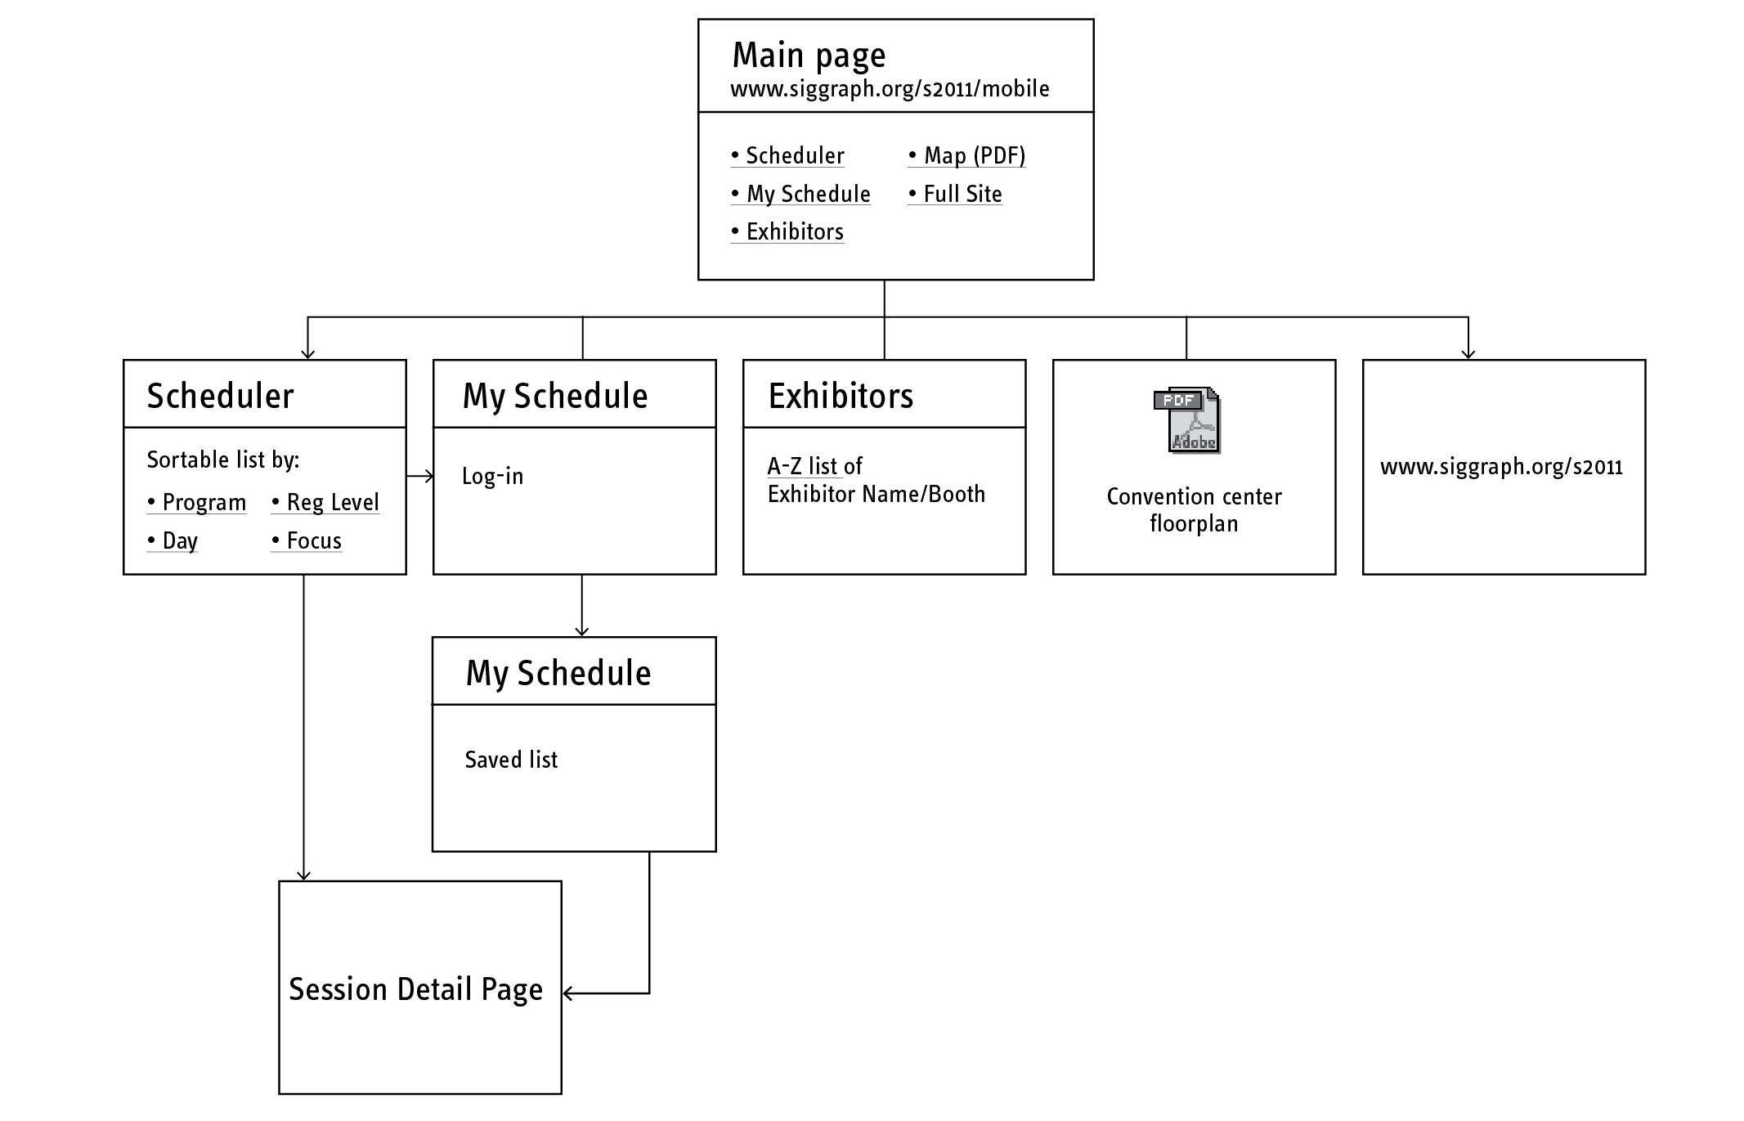
Best Practices for designing with Context in Mind
Keep the Information Architecture Simple

Slide 57
Time to Introduce Yourselves
Name
Where are you from?
Languages you speak?
Try to talk about something which your interested in for about 2 minutes (Ex: I am a big fan of sports, etc)

Slide 58
Android application development environment

Slide 59
Setting up
Setting up Android Studio is fairly straightforward and is easier than ever thanks to nearly everything being bundled into one installer.
Download it and you’ll get not only Android Studio but also the Android SDK, the SDK manager and more.
The only other thing you’ll need is the Java Development Kit,.
Remember, Android Studio is only really your window into Java! Note: Android Studio and the SDK are rather large, so make sure you have some space free on your C:\ drive before you get started.

Slide 60
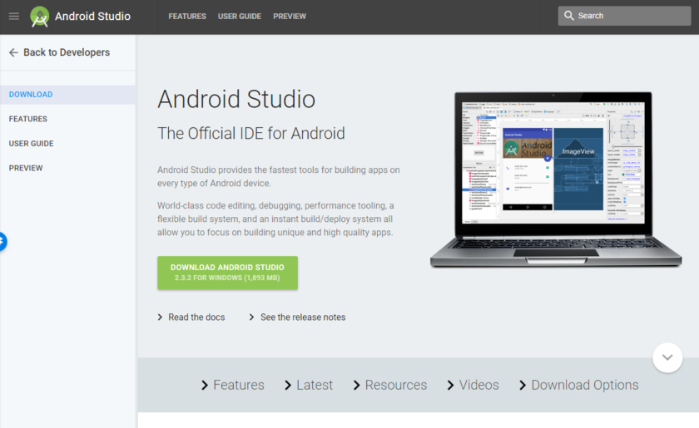

Slide 61
Setting up
Follow the simple instructions during installation and it should also set you up with an Android platform that you will be able to develop with as well.
Be sure to tick the checkbox to tell the installer that you want the Android SDK as well and make a note of where Android Studio itself and the SDK are being installed. These are the defaults that it selected for my installation:
Pick a directory for the SDK that has no spaces in it.
Note that the AppData folder that Android Studio has selected here is a hidden folder in Windows.
That means you’ll need to select ‘Show Hidden Folders’ if you want to browse to it using the explorer.

Slide 62
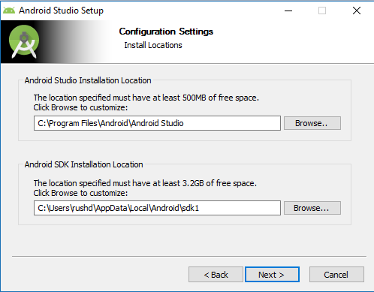

Slide 63
Starting a new project
Once Android Studio is up and running, you’ll want to dive in and create a new project.
You can do this by launching Android Studio and then selecting New Project, or you can choose File > New > New Project at any time from the IDE itself.

Slide 64
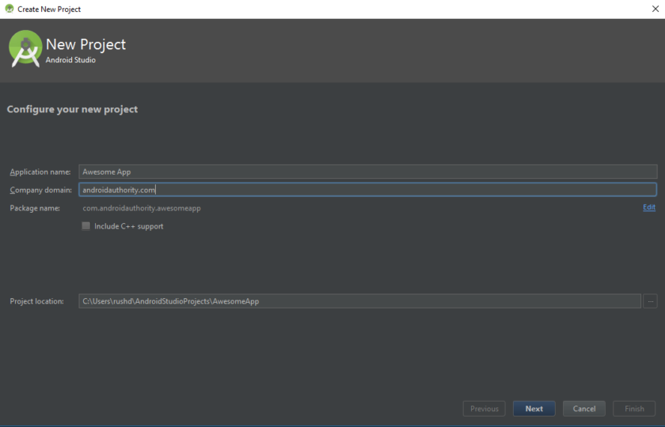

Slide 65
Starting a new project
You’ll then have the opportunity to choose from a number of different types of activity.
Activities are effectively ‘screens’ in an app. In some cases, this will be the entire app or in others, your app might transition from one screen to the next.
You’re free to start a new project with no activity (in which case, you would choose ‘Add No Activity’) but you’ll almost always want one, so it’s easier to let Android Studio set you up with something resembling a blank app template to begin with.

Slide 66
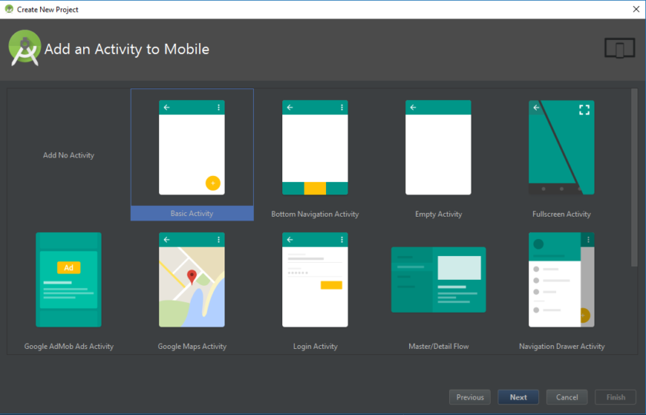

Slide 67
Starting a new project
Often you’ll choose a ‘Basic Activity’, which is the default look and feel for a new Android App. This will include a menu in the top right corner, as well as a FAB button – Floating Action Button – which is a design choice that Google is trying to encourage. An ‘Empty Activity’ is the same thing but without the added chrome.
Pick the option that best suits the app you have in mind to build and this will impact on the kind of files you are presented with when you first start things up. You’ll also be able to choose your app’s name at this point, the minimum Android SDK you want to support and the package name. The package name is the final file name that the app will have when you upload it to the Play Store – a combination of the app’s name, along with the name of the developer.

Slide 68
Meet Gradle
Android Studio tries to keep things nice and simple for users by providing all of the necessary tools and features in one place.
Things only get more complicated once you need to interact with some of these other elements.
For instance, you might notice that Android Studio mentions ‘Gradle’ occasionally. This is a ‘build automation tool’ which essentially helps Android Studio to turn all those different files into one single APK.
You should be able to leave Gradle to do its thing most of the time, but you will occasionally need to jump into the build.gradle files
if you want to add a new ‘dependency’ allowing advanced features for your app. Sometimes, if things stop working, you can choose Build > Clean Project and this will essentially reaffirm where all the files are and what their roles are. There are normally going to be two of these Gradle build files, one for the whole project and one for the ‘module’ (the app).

Slide 69
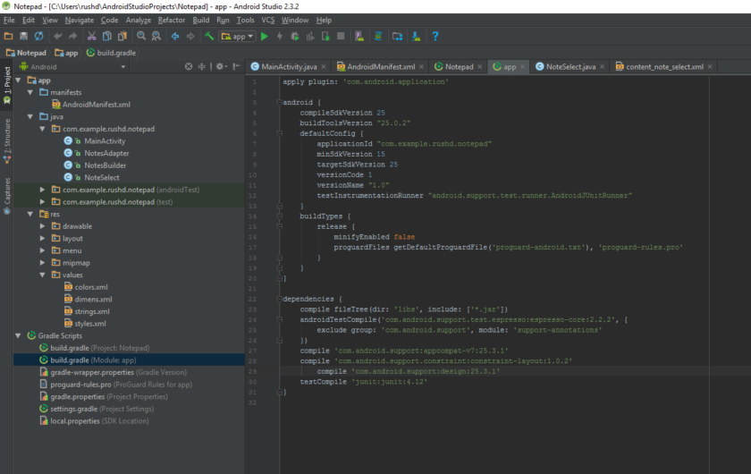

Slide 70
Debugging, virtual devices and the SDK manager
Once you’re ready to test your app, you have two options. One is to run it on your physical device and the other is to create a virtual device (emulator) to test it on.
Running it on your device is simple. Just plug it in via USB, make sure you’ve allowed USB debugging and installations from unknown sources in your phone’s settings and then hit the green play button at the top, or ‘Run > Run App’.
You’ll see a message telling you that Gradle build is running (i.e. your code is being made into a full app) and then it should spring to life on your device. This is faster than ever right now thanks to the Instant Run feature.

Slide 71
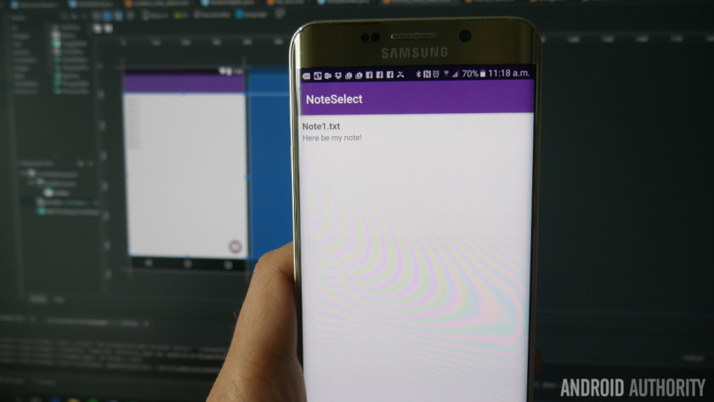

Slide 72
App Live Reports
While your app is running, you’ll be able to get live reports through the ‘logcat’ tab in the Android Monitor, found in the lower half of the screen.
Should something go wrong causing your app to crash or become unresponsive, then red text will appear and this will give you a description of the problem. You might find that it’s just a matter of having forgotten permissions or something else that’s easy to fix.
It essentially saves you a ton of time versus blindly trying to guess what went wrong. Make sure to filter the types of messages you want to see here.

Slide 73
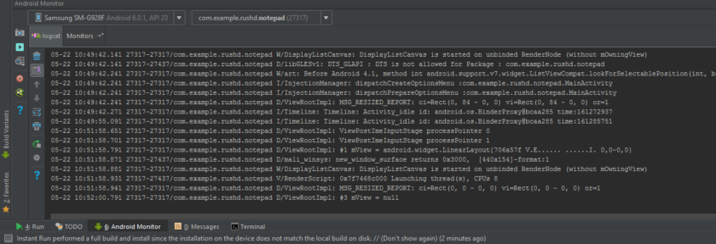

Slide 74
App Live Reports
You can also switch to the monitors tab and see useful information such as the CPU usage etc. The Android Device Monitor takes this monitoring a step further and lets you monitor everything at once, complete with handy UI.

Slide 75
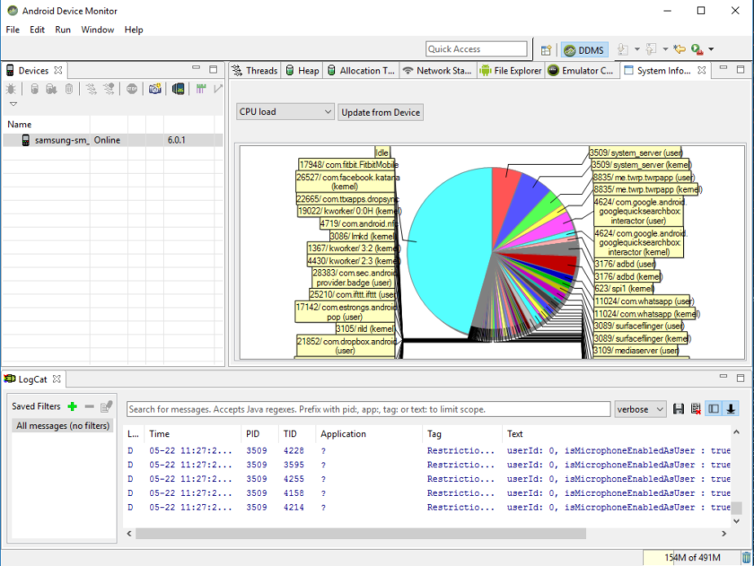

Slide 76
AVD Manager
It’s unlikely you’d ever want to develop for Android without some kind of Android device in your possession. However, one of the biggest challenges for Android devs is fragmentation. In other words: it’s not good enough that your app works on your device, it also needs to work on 10″ and 15″ devices. And it needs to work on devices that are running older versions of Android or that are very underpowered.
This is where the ‘Android Virtual Device’ comes in. This is essentially an emulator that you can use to mimic the look and performance of any other Android device, setting such things as screen size, power and Android version.

Slide 77
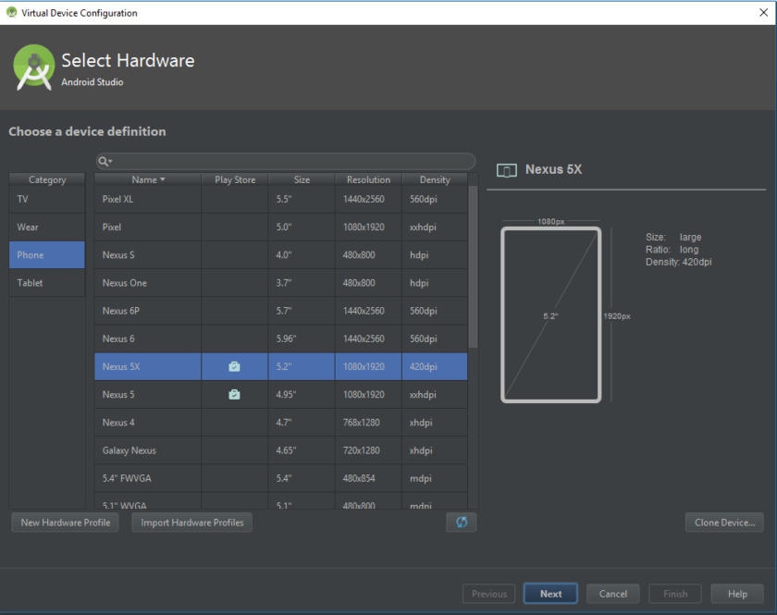

Slide 78
AVD Manager
To use the virtual device though, you first need to build one by downloading the required components and setting the specifications as you want them. To do this, navigate to Tools > Android > AVD Manager.
You’ll then choose your hardware and choose the Android platform you want it to run. If the Android version you want to run hasn’t been downloaded yet, then the option will be presented next to it.

Slide 79
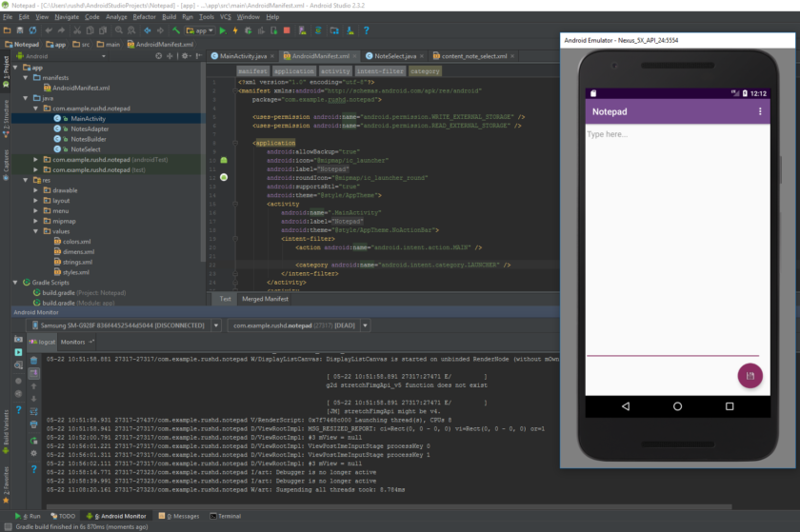

Slide 80
The SDK Manager
If you want to target a specific version of Android, or if you want to create a virtual device running a specific version, then you are going to need to download the necessary platform and SDK tools.
You can do this through the SDK manager, which you’ll find by selecting Tools > SDK Manager.
In here, you’ll also be able to find additional resources such as the Google Glass Development Kit or the Android Repository which provides you with additional functionality to use in your app.

Slide 81
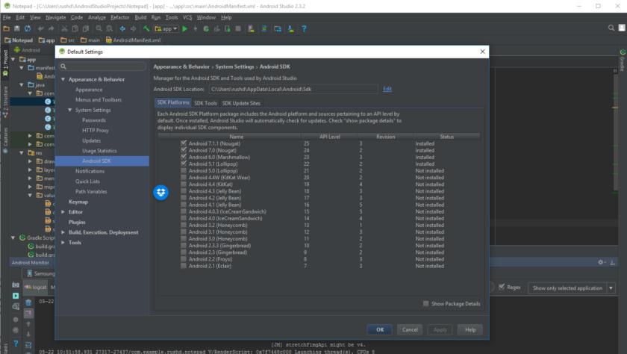

Slide 82
Creating signed APKs
Finally, once you’re done testing your app and you’re ready to release it into the great wide world, you’ll want to select Build > Generate Signed APK.
This will give you the file you’ll need to upload to Google Play and which will contain all of the various files, resources and more.
You’ll be prompted to create or enter a Key store.
This is a kind of ‘certificate of authenticity’ that proves the APK you’re uploading is the app you’re saying it is.
This prevents someone from hacking your Google Play account and then uploading a malicious APK as an ‘update’ to your app!
You’ll need to keep this file safe, as once it’s lost, there’s no way to update your app again! Choose ‘release’ as your build type if you want to make this something that you can release and then click ‘finish’.

Slide 83
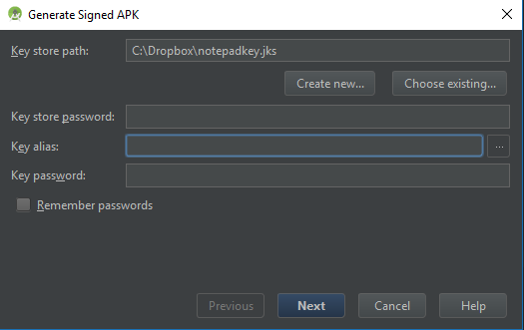

Slide 84
PBL – Review - 1
PowerPoint presentation about your work is compulsory
Team Members
Project Title
Summary of your project
Tools used
What will the output be
Date: 29/07/2019 During the lecture hour

